Slide 2
Agenda
Introduction
Architecture
Components
Data binding
Routing
…

Slide 3

Agenda

Slide 4
Agenda

Slide 5
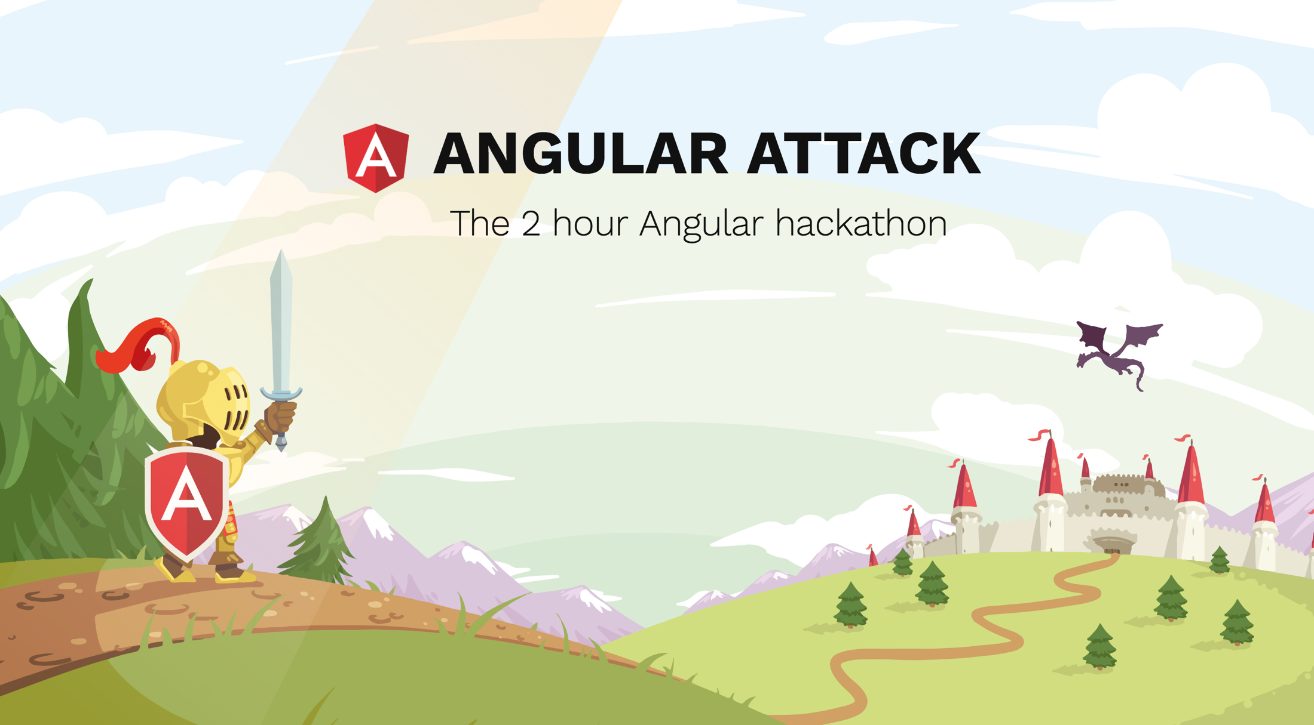
Agenda

Slide 7
TypeScript
Superset of JavaScript
Compiles to vanilla JavaScript
Designed for development of large applications
Notes:
Developed by MicroSoft
adds extra features and syntax – fully compatible with ES 6
Browser can’t read TS – transpile with TSC
TSC installed via NPM ( npm install –g typescript )

Slide 8
TypeScript
Static type checking
Class based objects
Modularity
ES6 features
Notes:
Static type checking – helps to prevent bugs
Classes – OO → interfaces, extend. No JS Prototypes anymore
Modularity - modules, import, export
ES6 features like arrow functions, LET + CONST for declaring variables

Slide 9
TypeScript
Basic types
string
number
boolean
Array
Tuple
any
void
object
null / undefined
https://www.typescriptlang.org/docs/handbook/basic-types.html
Notes:
Tuple -> Array where the type of a fixed number of elements is known
object – non primitive type (string, number, boolean, null)
null and undefined are subtypes of all other types
when using the --strictNullChecks flag, null and undefined are only assignable to void and their respective types
In cases where you want to pass in either a string or null or undefined, you can use the union type string | null | undefined

Slide 10
TypeScript
OO
Inheritance
Interface
import / export
Access modifiers
public, private, protected
Variables
let, const, var
optional
readonly
static
union

Slide 11
TypeScript
Demo

Slide 13
Angular
Angular is a JavaScript framework
which allows you to create reactive
Single Page Applications (SPAs)
Notes:
Angular is a platform that makes it easy to build applications with the web.
Angular combines declarative templates, dependency injection, end to end tooling, and integrated best practices to solve development challenges.

Slide 14
Angular - Architecture
NgModule
Notes:
NgModule declares a compilation context for a set of components that is dedicated to an application domain, a workflow, or a closely related set of capabilities.
An NgModule can associate its components with related code, such as services, to form functional units.
Every Angular app has a root module, conventionally named AppModule, which provides the bootstrap mechanism that launches the application.
An app typically contains many functional modules.

Slide 15
Angular - Architecture
NgModule
Notes:
NgModules can import functionality from other NgModules, and allow their own functionality to be exported and used by other NgModules.

Slide 16
Angular - Architecture
NgModule
Notes:
Organizing your code into functional modules helps :
managing development of complex applications
designing for reusability
lazy-loading —loading modules on demand— in order to minimize the amount of code that needs to be loaded at startup.

Slide 17
Angular - Architecture
NgModule
@Component
Notes:
Components define views, which are sets of screen elements that Angular can choose among and modify according to your program logic and data.
Components should focus on one main topic, ie:
Displaying a list
Displaying a detail screen
Card
Components are:
reusable
easy to update
limited in scope
Every Angular application has at least one component, the root component that connects a component hierarchy with the page DOM.
Each component defines a class that contains application data and logic, and is associated with an HTML template that defines a view to be displayed in a target environment.
The @Component decorator identifies the class immediately below it as a component, and provides the template and related component-specific metadata

Slide 18
Angular - Architecture
NgModule
@Component
Notes:
Components define views, which are sets of screen elements that Angular can choose among and modify according to your program logic and data.
Every Angular application has at least one component, the root component that connects a component hierarchy with the page DOM.
Each component defines a class that contains application data and logic, and is associated with an HTML template that defines a view to be displayed in a target environment.
The @Component decorator identifies the class immediately below it as a component, and provides the template and related component-specific metadata

Slide 19

Angular - Architecture
NgModule
@Component
< class >
< template >
Notes:
The class contains business logic
The template combines HTML with Angular markup that can modify the HTML elements before they are displayed.
Template directives provide program logic, and binding markup connects your application data and the document object model (DOM).

Slide 20
Angular - Architecture
NgModule
@Component
property binding
< class >
< template >
Notes:
Data binding:
Property binding lets you interpolate values that are computed from your application data into the HTML.
Event binding lets your app respond to user input in the target environment by updating your application data.
Before a view is displayed, Angular evaluates the directives and resolves the binding syntax in the template to modify the HTML elements and the DOM, according to your program data and logic. Angular supports two-way data binding, meaning that changes in the DOM, such as user choices, can also be reflected back into your program data.
Your templates can also use pipes to improve the user experience by transforming values for display. Use pipes to display, for example, dates and currency values in a way appropriate to the user's locale. Angular provides predefined pipes for common transformations, and you can also define your own.

Slide 21
Angular - Architecture
NgModule
@Component
property binding
< class >
< template >
event binding
Notes:
Data binding:
Property binding lets you interpolate values that are computed from your application data into the HTML.
Event binding lets your app respond to user input in the target environment by updating your application data.
Before a view is displayed, Angular evaluates the directives and resolves the binding syntax in the template to modify the HTML elements and the DOM, according to your program data and logic. Angular supports two-way data binding, meaning that changes in the DOM, such as user choices, can also be reflected back into your program data.
Your templates can also use pipes to improve the user experience by transforming values for display. Use pipes to display, for example, dates and currency values in a way appropriate to the user's locale. Angular provides predefined pipes for common transformations, and you can also define your own.

Slide 22
Angular - Architecture
NgModule
@Component
< class >
< template >
Notes:
Data binding:
Property binding lets you interpolate values that are computed from your application data into the HTML.
Event binding lets your app respond to user input in the target environment by updating your application data.
Before a view is displayed, Angular evaluates the directives and resolves the binding syntax in the template to modify the HTML elements and the DOM, according to your program data and logic. Angular supports two-way data binding, meaning that changes in the DOM, such as user choices, can also be reflected back into your program data.
Your templates can also use pipes to improve the user experience by transforming values for display. Use pipes to display, for example, dates and currency values in a way appropriate to the user's locale. Angular provides predefined pipes for common transformations, and you can also define your own.

Slide 23

Angular - Architecture
NgModule
@Component
< class >
< template >

Slide 24
Angular - Architecture
NgModule
@Component
< class >
< template >
@Injectable
< service >
Notes:
For data or logic that is not associated with a specific view, and that you want to share across components, you create a service class.
A service class definition is immediately preceded by the @Injectable decorator. T
he decorator provides the metadata that allows your service to be injected into client components as a dependency.
Dependency injection lets you keep your component classes lean and efficient.
They don't fetch data from the server, validate user input, or log directly to the console; they delegate such tasks to services.

Slide 25
Angular - Architecture
NgModule
@Component
directive
< class >
< template >
@Injectable
< service >
Notes:
Angular templates are dynamic. When Angular renders them, it transforms the DOM according to the instructions given by directives.
A directive is a class with a @Directive decorator.
A component is technically a directive - but components are so distinctive and central to Angular applications that Angular defines the @Component decorator, which extends the @Directive decorator with template-oriented features.
There are two kinds of directives:
- structural directives - change DOM
- attribute directives - only change the element they where it's placed on

Slide 26
Angular - Architecture
NgModule
@Component
directive
< class >
< template >
pipe
@Injectable
< service >
Notes:
Pipes let you declare display-value transformations in your template HTML.
A class with the @Pipe decorator defines a function that transforms input values to output values for display in a view.
Angular defines various pipes, such as the date pipe and currency pipe; for a complete list, see the Pipes API list. You can also define new pipes.

Slide 27
Angular - Architecture
NgModule
@Component
RouterModule
directive
< class >
< template >
pipe
@Injectable
< service >

Slide 28
Angular - Architecture
NgModule
@Component
RouterModule
directive
< class >
< template >
HttpClientModule
pipe
@Injectable
< service >
Notes:
Most front-end applications communicate with backend services over the HTTP protocol.
Modern browsers support two different APIs for making HTTP requests: the XMLHttpRequest interface and the fetch() API.
The HttpClient in @angular/common/http offers a simplified client HTTP API for Angular applications that rests on the XMLHttpRequest interface exposed by browsers.
Additional benefits of HttpClient include testability features, typed request and response objects, request and response interception, Observableapis, and streamlined error handling

Slide 29
Angular - Architecture
NgModule
@Component
RouterModule
directive
< class >
< template >
HttpClientModule
pipe
@Injectable
< service >

Slide 30
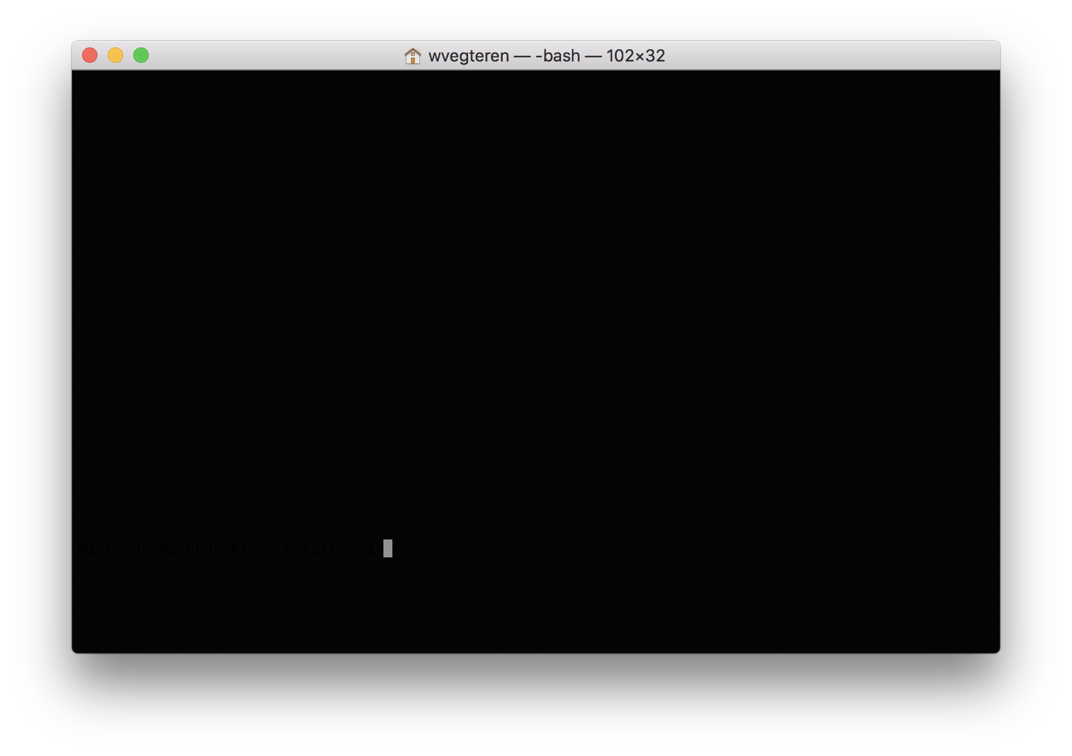
Angular - CLI
> npm install – g @angular/cli
Notes:
The Angular CLI makes it easy to create an application that already works, right out of the box.
It already follows the best practices defined by the Angular team

Slide 31
Angular - CLI
> ng new my-project
--routing
--skip-tests
--inline-style
> cd my-project
> ng serve
Notes:
ng new – creates a new angular app
-
ng serve - starts server http://localhost:4200/ The app will automatically reload if you change any of the source files.

Slide 32
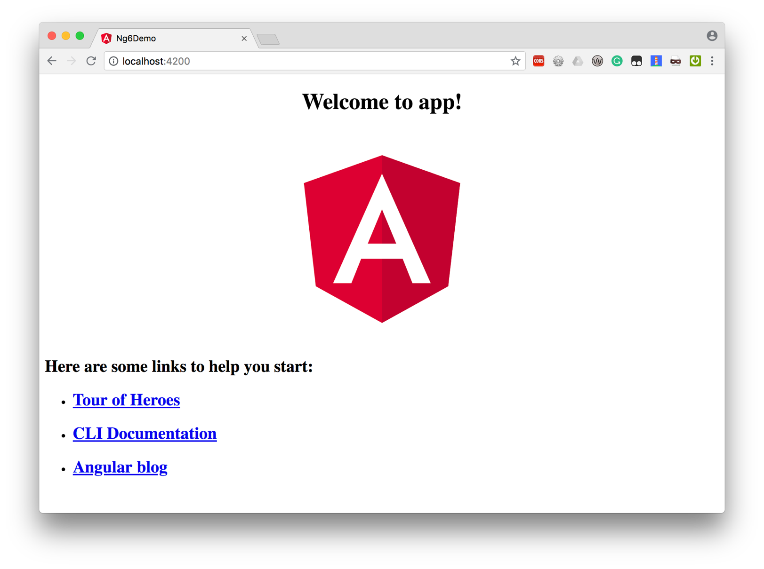
Angular
Notes:
explore project structure
bootstrap:
index.html -> main.js (compiled version of main.ts)
-> Bootstrap module AppModule
-> NgModule - bootstrap: [AppComponent]
In index.html component <app-root> is loaded. -> app.component.ts + app.component.html

Slide 33
Angular - CLI
> ng new my-project
--routing
--skip-tests
--inline-style
> cd my-project
> ng serve
> ng generate component MyFirstComponent
> ng g c MySecondComponent
> ng generate service MyService
> ng test
> ng e2e
> ng build
--prod
Notes:
ng generate – module, component, service, directive, pipe, etc
ng test – run unit tests with Karma
ng e2e – runs end 2 end tests with Protractor.
See for all options -> https://cli.angular.io

Slide 34
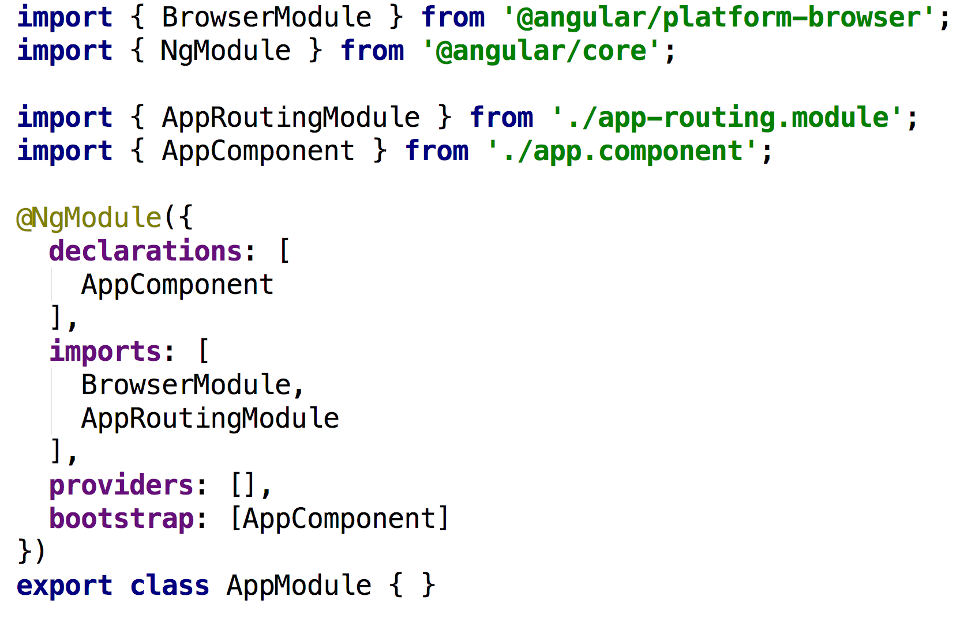
Angular - NgModule
Notes:
An NgModule is defined as a class decorated with @NgModule. The most important properties are:
declarations — The components, directives, and pipes that belong to this NgModule.
imports — Other modules whose exported classes are needed by component templates declared in this NgModule.
providers — Creators of services that this NgModule contributes to the global collection of services; they become accessible in all parts of the app. (You can also specify providers at the component level, which is often preferred.)
bootstrap—The main application view, called the root component, which hosts all other app views. Only the root NgModule should set this bootstrapproperty.

Slide 35
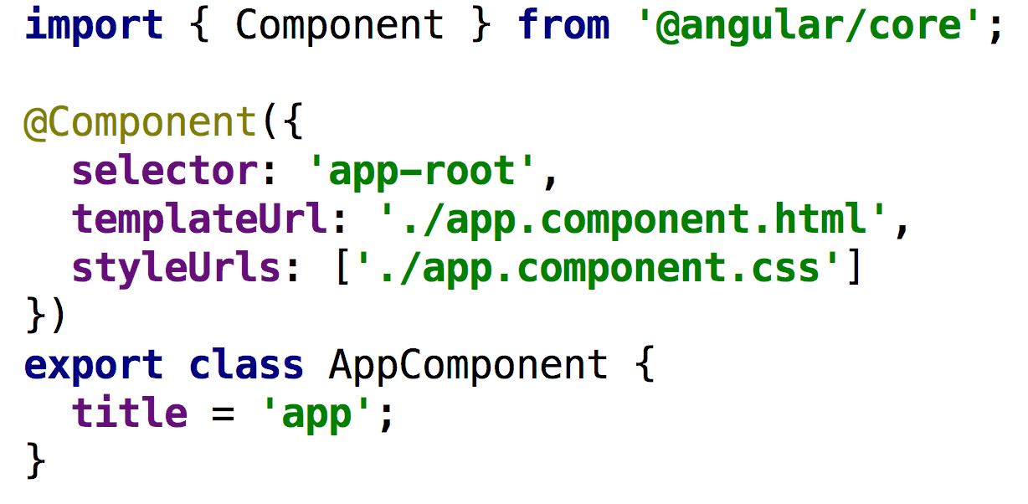
Angular - @Component
Notes:
The metadata for a component tells Angular where to get the major building blocks it needs to create and present the component and its view.
In particular, it associates a template with the component, either directly with inline code, or by reference. Together, the component and its template describe a view.
In addition to containing or pointing to the template, the @Component metadata configures, for example, how the component can be referenced in HTML and what services it requires.
selector needs to be unique
templateUrl vs template
styleUrls vs styles
provider
Components need to be registered within the declarations array of a module (ie. iapp.module.ts)

Slide 36
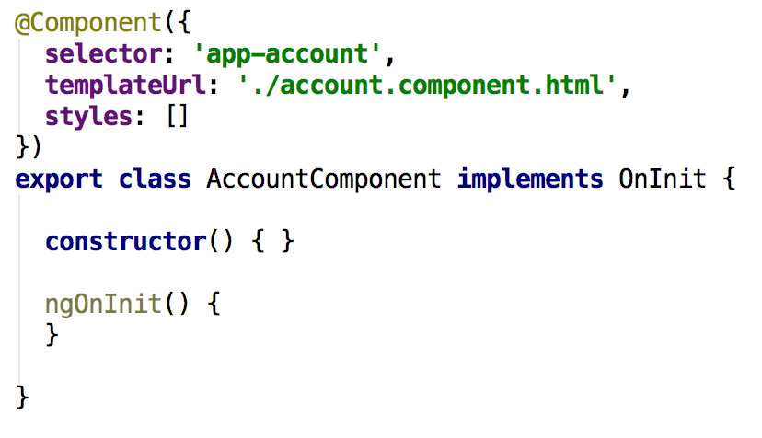
Angular - @Component
Notes:
When generating a component via CLI a ngOnInit function is added as well
ngOnInit is a lifecycle hook
Angular calls ngOnInit shortly after creating a component.
It's a good place to put initialization logic.
ngOnDestroy() is called Called just before Angular destroys the directive/component
Place to unsubscribe Observables and detach event handlers to avoid memory leaks.
See https://angular.io/guide/lifecycle-hooks for more information

Slide 37
Angular - Data binding
Output data in html
string interpolation : {{ account.name }}
property binding: [disabled]="!allowNewAccount"
Notes:
= communication between TypeScript code (business logic) and Template (html)
String interpolation:
○ between curly braces everything is allowed that resolves to a string or can be converted to a string (like number)
○ static info als 'test', method calls, etc
○ multiline expressions are not possible
Property binding ie. [disabled]="!allowNewAccount"
○ data needs to resolve to the type required by the property ... in disabled case a Boolean
ie. [disabled]="!allowNewAccount"

Slide 38
Angular - Data binding
React to user events
event binding : (click)="onCreate()"
(click)="onCreate($event)"
Notes:
event is named between the parentheses ie. (click)="onCreate()" method in TypeScript ... convention start with on ... ie. onCreate() reserved $event -> ie. onCreate($event) -> provide method with event data
onClick(event: Event) { this.title = (<HTMLInputElement>event.target).value; }

Slide 39
Angular - Data binding
Combine property and event binding
Two way binding : [(ngModel)]="data"
ngModel directive requires the FormsModule from @angular/forms
Notes:
Two way binding, combination of output data and react to user events
banana in the box

Slide 40
Angular - Directives
Structural directives
conditionally add or remove elements from DOM
* preceeds name of directive
<p *ngIf="accountCreated">Account created</p> <p *ngFor="let account of accounts"> … </p>
Non Structural directives
only change the element where directive is placed on
<p [ngStyle]="backgroundColor: getColor()"> … </p> <p [ngClass]="active: state == 'active'"> ... </p>
Notes:
Directives are instructions in the DOM
Non Structural - behind the colon an expression is expected

Slide 41
Angular - Pipes
A pipe transforms input data to a desired output
{{ birthday | date }}
{{ birthday | date:'fullDate' | uppercase }}
{{ balance | currency:'EUR' }}
https://angular.io/guide/pipes
Notes:
Pipes can be chained

Slide 42
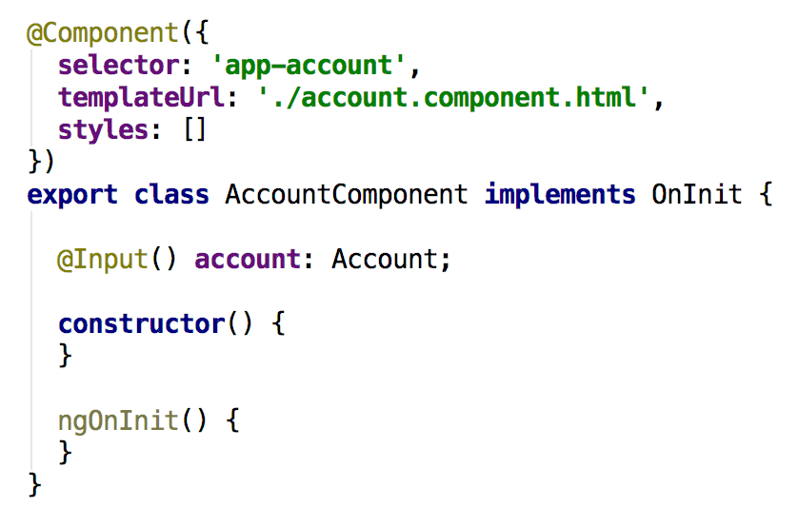
Angular - Component interaction
Notes:
From Master to Detail -> ie. when selecting an account from a list …
- Use the @Input decorator to make the selected account available for binding
- Use property binding to pass the selected account to the account (details) component
You can define the @Input() decorator on variables … and functions (ie. setAccount()) as well
Detect and act upon changes to input property values with the ngOnChanges() lifecycle hook

Slide 43
Angular - Component interaction
Root Component
Account List Component
@Output()
@Input()
Account Detail Component
Notes:
The child component exposes an EventEmitter property with which it emits events when something happens.
The parent binds to that event property and reacts to those events.
The child's EventEmitter property is an output property, typically adorned with an @Output decoration

Slide 44
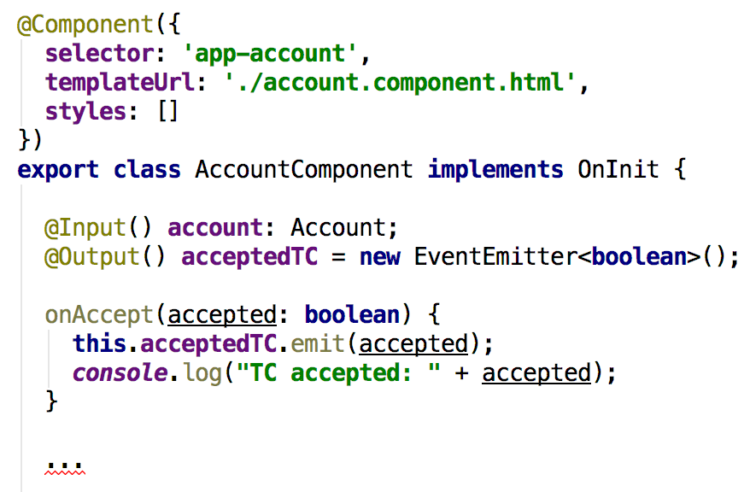
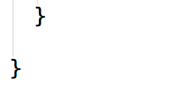
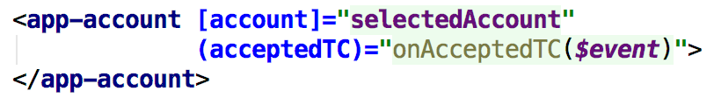
Angular - Component interaction
Notes:
The child component exposes an EventEmitter property with which it emits events when something happens.
The parent binds to that event property and reacts to those events.
The child's EventEmitter property is an output property, typically adorned with an @Output decoration
Another way for component interaction is a shared Service

Slide 45
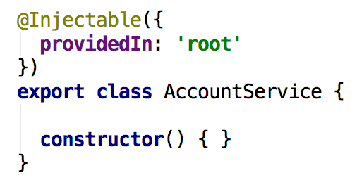
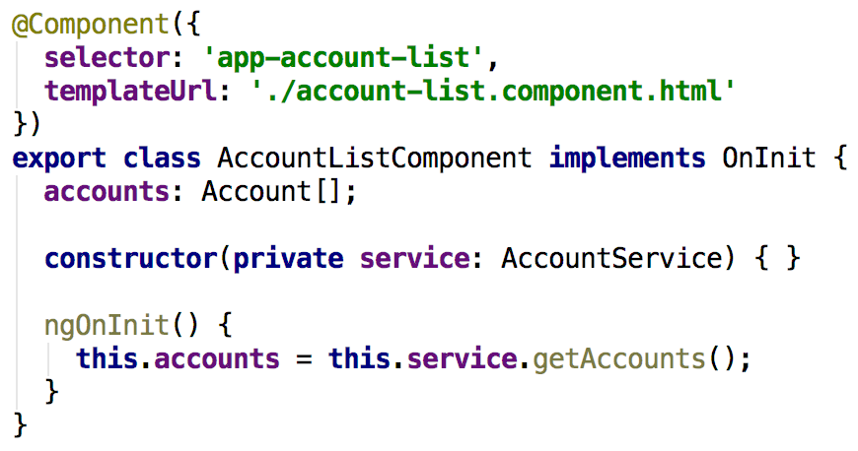
Angular - @Injectable
Notes:
ng generate service or ng g s
By default providedIn root -> global service, available for all components in the application
Injected via constructor – private varable !!!

Slide 46
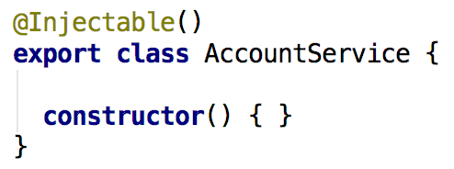
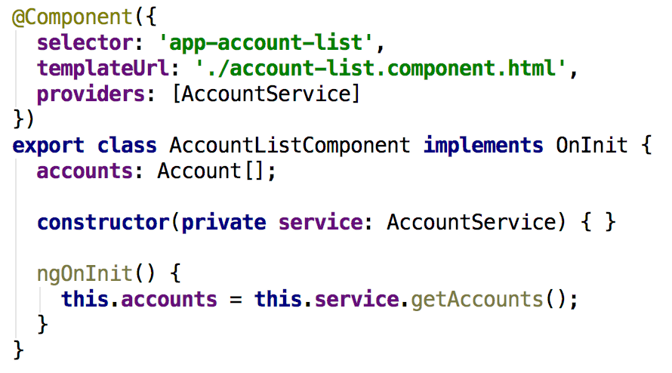
Angular - @Injectable
Notes:
providedIn root is optional.
When removed the Injectable needs to be added to the providers section of a module, component, etc.
In this case the AccountService is only available for the AccountListComponent

Slide 47
Angular - Observables
Observables provide support for passing messages
between publishers and subscribers in your application.
Observables are not executed until a consumer subscribes to it.
The subscribed consumer then receives notifications
until the function completes, or until they unsubscribe.
Notes:
Part of RxJs
An observable can deliver multiple values of any type—literals, messages, or events, depending on the context.
The API for receiving values is the same whether the values are delivered synchronously or asynchronously.
Because setup and teardown logic are both handled by the observable, your application code only needs to worry about subscribing to consume values, and when done, unsubscribing. Whether the stream was keystrokes, an HTTP response, or an interval timer, the interface for listening to values and stopping listening is the same.
Because of these advantages, observables are used extensively within Angular

Slide 48
Angular - Observables
Angular makes use of observables as an interface to handle
a variety of common asynchronous operations. For example:
The EventEmitter class extends Observable.
The HTTP module uses observables to handle AJAX requests and responses.
The Router and Forms modules use observables to listen for and respond to user-input events.
https://angular.io/guide/observables

Slide 49
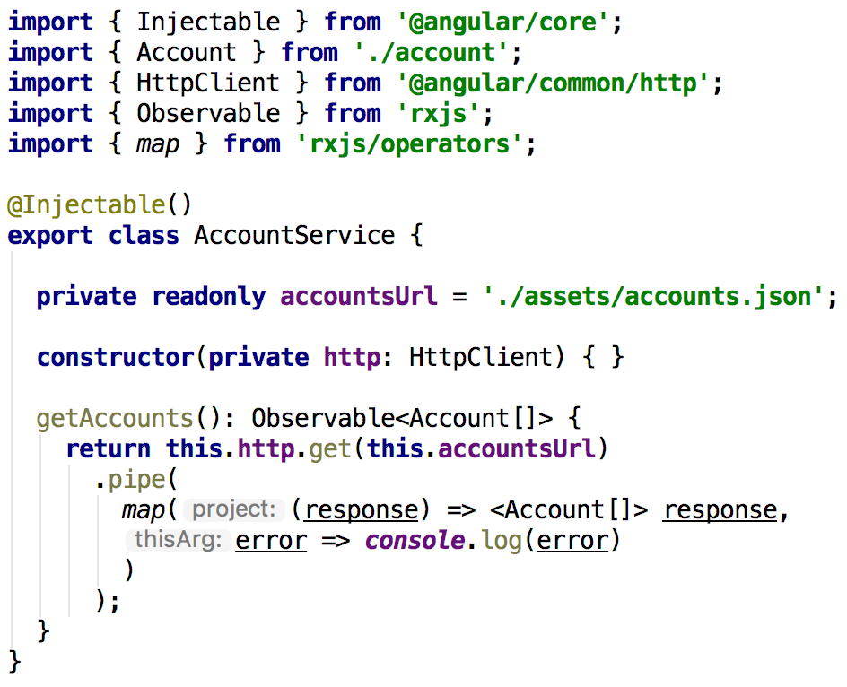
Angular - HttpClient
https://angular.io/guide/rx-library
Notes:
pipe() function takes as its arguments the functions you want to combine, and returns a new function that, when executed, runs the composed functions in sequence.
map() transforms response to object

Slide 50
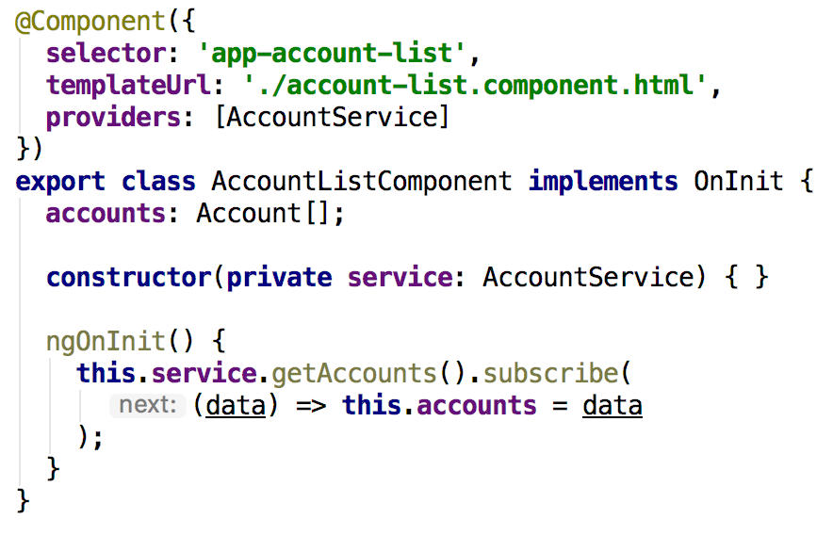
Angular - HttpClient
Notes:
You need to subscribe to an Observable

Slide 51
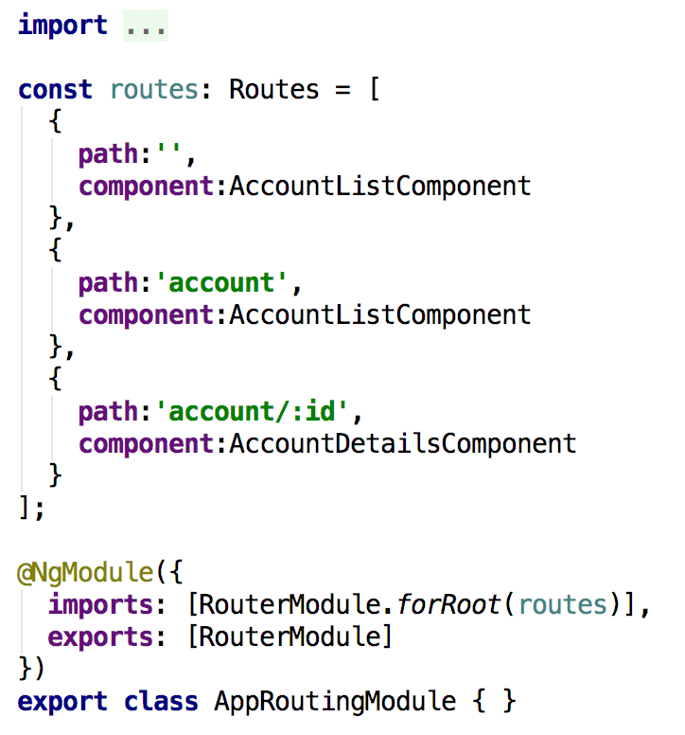
Angular - Routing
Notes:
A routed Angular application has one singleton instance of the Router service.
When the browser's URL changes, that router looks for a corresponding Route from which it can determine the component to display.
app-routing.module.ts - generated by CLI ( --routing ) … with empty routes array.
Each route needs at least a path and a component. There are no leading slashes in the path.
** path is a wildcard -> page not found (404)
The order of the routes in the configuration matters and this is by design. The router uses a first-match wins strategy when matching routes,

Slide 52
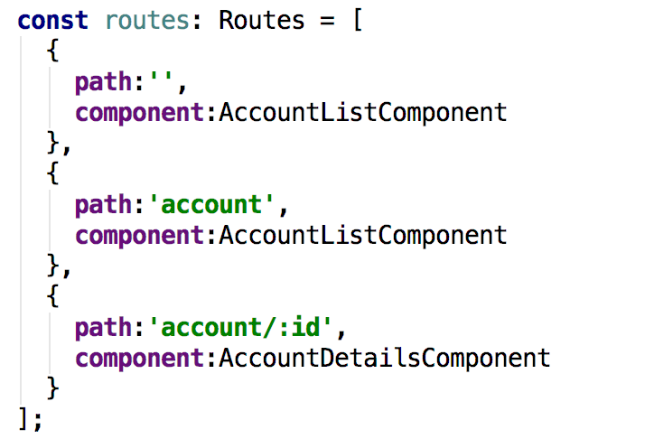
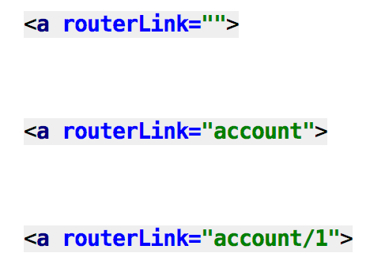
Angular - Routing
<a routerLink="">
<a routerLink="posts">
<a routerLink="account/1234">
Notes:
Routes translated to links in HTML template
Use routerlink directive in stead of a href=“”. Href is releoading the page … execute a full bootstrap, etc.
Routerlink
routerlink:
/account – absolute path
account – relative path … wil be added to the current path
You need to define a <router-outlet> directive in your template to display the component that is activated by a route

Slide 53
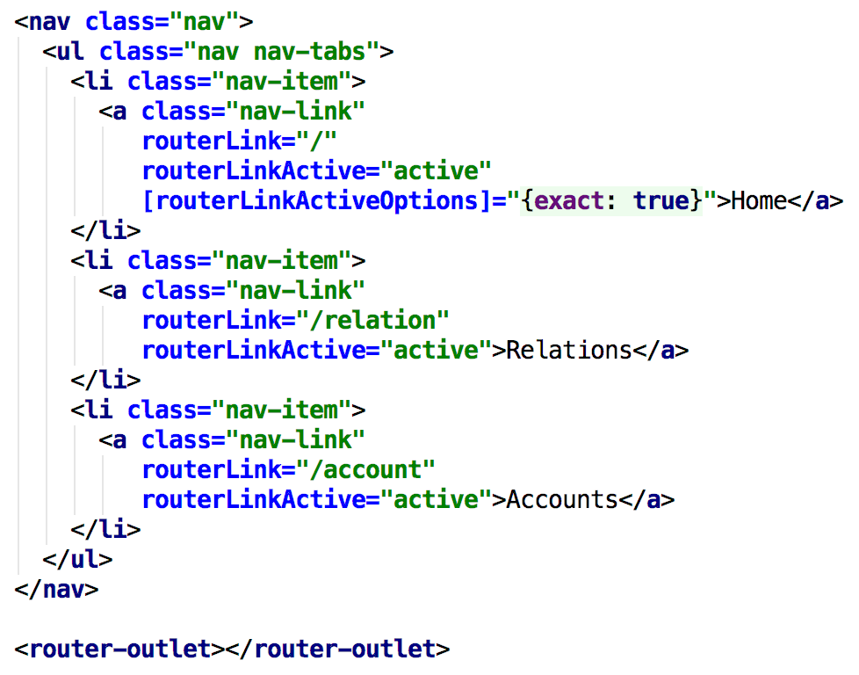
Angular - Routing
Notes:
Routes translated to links in HTML template
Use routerLink directive in stead of a href=“”. Href is releoading the page … execute a full bootstrap, etc.
RouterLink
routerLink:
/account – absolute path
account – relative path … wil be added to the current path
You need to define a <router-outlet> directive in your template to display the component that is activated by a route

Slide 54
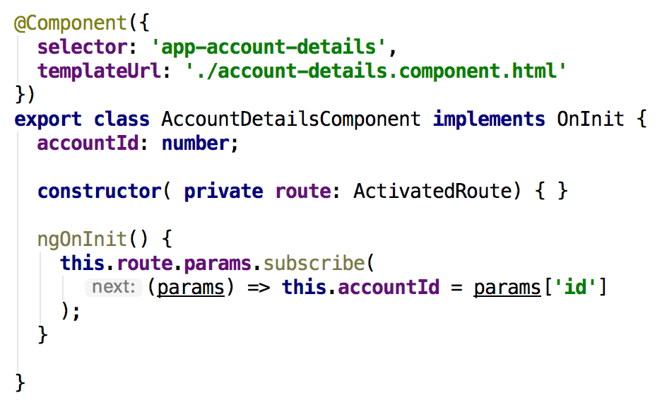
Angular - Routing
Notes:
The route path and parameters are available through an injected router service called the ActivatedRoute.
Note: params.id maps to :id in route definition
Check Router,RoutingEvents

Slide 55
Angular - Routing
Notes:
The route path and parameters are available through an injected router service called the ActivatedRoute.
Note: params.id maps to :id in route definition
Check Router,RoutingEvents

Slide 56
Angular - Routing
Notes:
The route path and parameters are available through an injected router service called the ActivatedRoute.
Note: params.id maps to :id in route definition
Check Router,RoutingEvents

Slide 57
Angular - Debugging
Chrome developer tools
console + debugger
Notes:
If something is not working as expected -> check console
At runtime only JavaScript is executed by the browser … error messages can be quite verbose and in example line numbers relate to the line numbers in the generated JavaScript code.
Developer tools – webpack -> access typescript code based on generated map-files

Slide 58
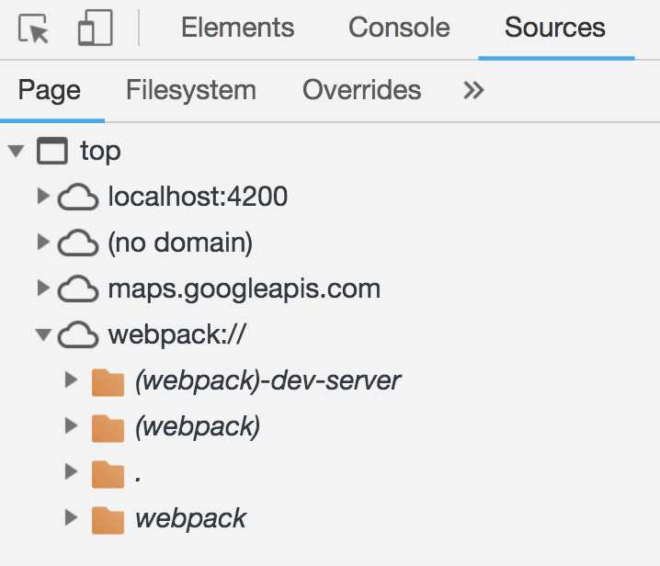
Angular - Debugging
Chrome developer tools
console + debugger
Notes:
Developer tools – Sources
- via webpack:// . folder => access to TypeScript code and debug TypeScript code
access typescript code based on generated map-files, so DEV only

Slide 59
Angular - Debugging
Chrome developer tools
console + debugger
Augury – extension for Chrome
https://augury.angular.io
Notes:
Augury helps to visualize the application through component trees, and visual debugging tools.
You get immediate insight into the application structure, change detection and performance characteristics.

Slide 60
It’s your turn …

Slide 61
Links
Reference
Style
https://angular.io/docs
https://material.angular.io
https://cli.angular.io
https://getbootstrap.com
APIs
https://www.programmableweb.com/category/all/apis
https://github.com/toddmotto/public-apis

Slide 62
Links
https://github.com/wvegteren/pizza-angular

